Slide 1
Supervised Machine Learning
By
Abhipray P. Paturkar
Massey University,
New Zealand

Slide 2
What is Machine Learning?
A computer program is said to learn from experience E with respect to some task T and some performance measure P, if its performance on T, as measured by P, improves with experience E.
Learning = Improving with experience at some task
T
E
P

Slide 3
Magic?
No, more like gardening
Seeds = Algorithms
Nutrients = Data
Gardener = You
Plants = Programs

Slide 4
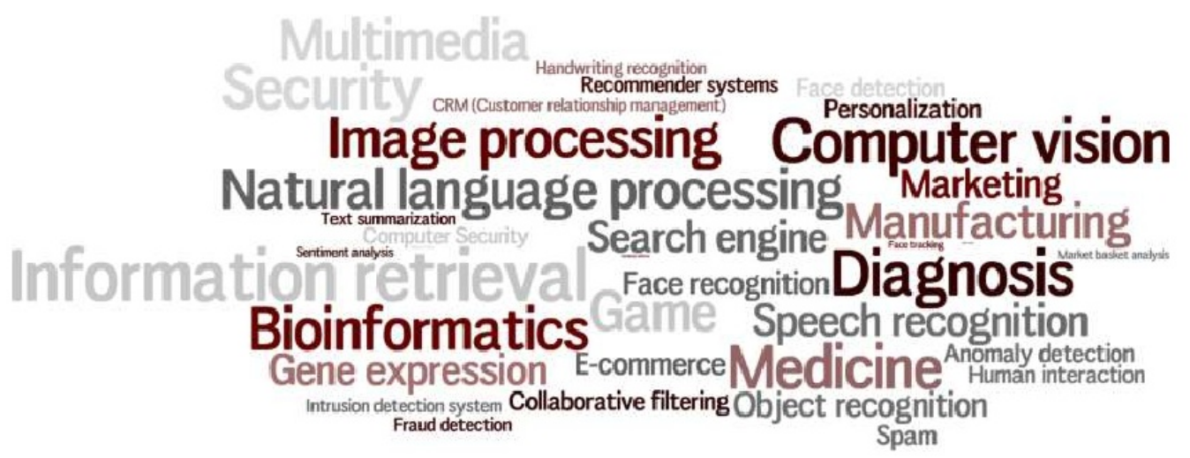
ML Applications

Slide 5
The Learning Process

Slide 6
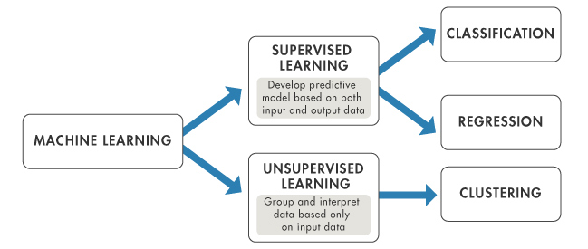
Machine Learning Algorithms

Slide 7
Supervised Machine Learning
We are given a dataset and we already know what our correct output should look like, having that idea that there is a relationalship between input and output.

Slide 8
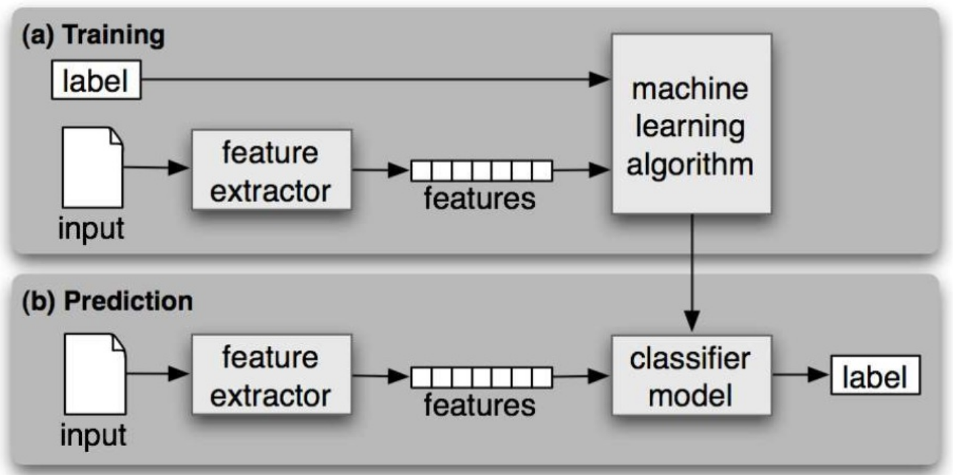
Workflow

Slide 9
Supervised Machine Learning
Regression
Regression means to predict output value using training data
If it is a real number/continuous then it is regression problem
Classification
Classification means to group the output into a class
If it is discrete data, then it is classification problem

Slide 10
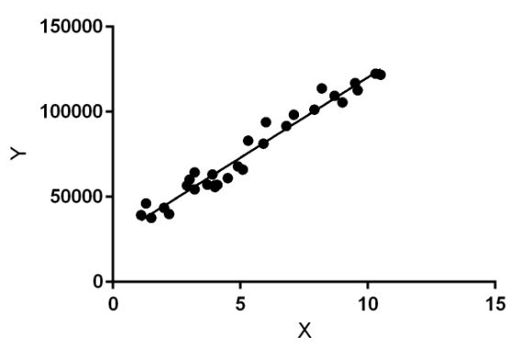
Linear Regression
Linear regression performs the task to predict a dependent variable value (y) based on a given independent variable (x).
This regression technique finds out a linear relationship between x (input) and y(output).
Salary
Hypothesis function for linear regression
Work Experience (years)

Slide 11
Pros and Cons
Pros
Linear regression is straightforward to understand and explain, and can be regularized to avoid overfitting.
Linear models can be updated easily with new data using gradient descent.
Cons
Linear regression performs poorly when there are non-linear relationships.
Adding the polynomial terms can be tricky and time-consuming.

Slide 12
Logistic Regression
Linear regression could help us to predict the student’s test score on a scale of 0 - 100.
Logistic Regression could help use to predict whether the student passed or failed.
Types of logistic regression:
Binary class (Pass/Fail)
Multi class (Cats, Dogs, Sheep)
Ordinal (Three or more classes e.g. Movie rating from 1 to 5)
Decision boundary: To predict which class a data belongs, a threshold can be set. Based upon this threshold, the obtained estimated probability is classified into classes.
Say, if predicted value ≥ 0.5, then classify student as Passed else as Failed.
Decision Boundary

Slide 13
Pros and Cons
Pros
Outputs have a nice probabilistic interpretation, and the algorithm can be regularized to avoid overfitting.
Logistic models can be updated easily with new data using gradient descent.
Cons
Logistic regression tends to underperform when there are multiple or non-linear decision boundaries.
They are not flexible enough to naturally capture more complex relationships.

Slide 14
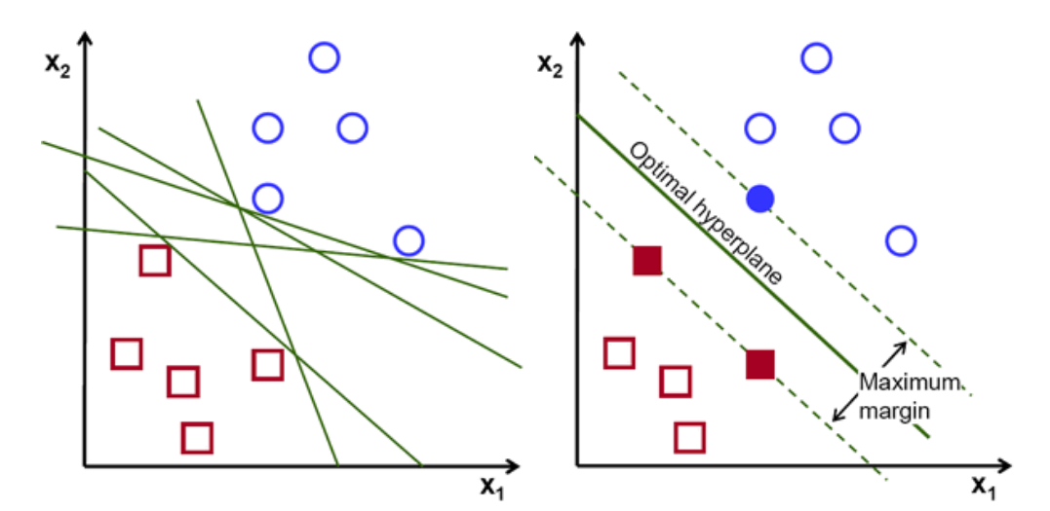
Support Vector Machine
SVM can be used for both regression and classification tasks. But, it is widely used in classification objectives.
The objective of the support vector machine algorithm is to find a hyperplane in an N-dimensional space(N — the number of features) that distinctly classifies the data points.
Hyperplanes are decision boundaries that help classify the data points.

Slide 15
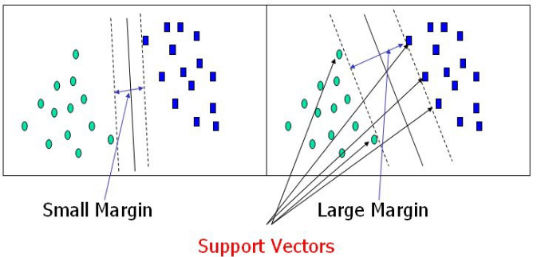
Support Vector Machine
Data points falling on either side of the hyperplane can be attributed to different classes.
Support vectors are data points that are closer to the hyperplane and influence the position and orientation of the hyperplane.
Using these support vectors, we maximize the margin of the classifier.
These are the points that help us build our SVM.

Slide 16
Pros and Cons
Pros
SVM's can model non-linear decision boundaries, and there are many kernels to choose from.
They are also fairly robust against overfitting, especially in high-dimensional space.
Cons
However, SVM's are memory intensive, trickier to tune due to the importance of picking the right kernel, and don't scale well to larger datasets.

Slide 17
Model Evaluation
How accurate is the classifier?
When the classifier is wrong, how is it wrong?
Answer:
Split the available data into a training set and a test set.
Train the classifier in the training set and evaluate based on the test set.
The accuracy of a classifier on a given test set is the percentage of test set elements that are correctly classified by the classifier.

Slide 18
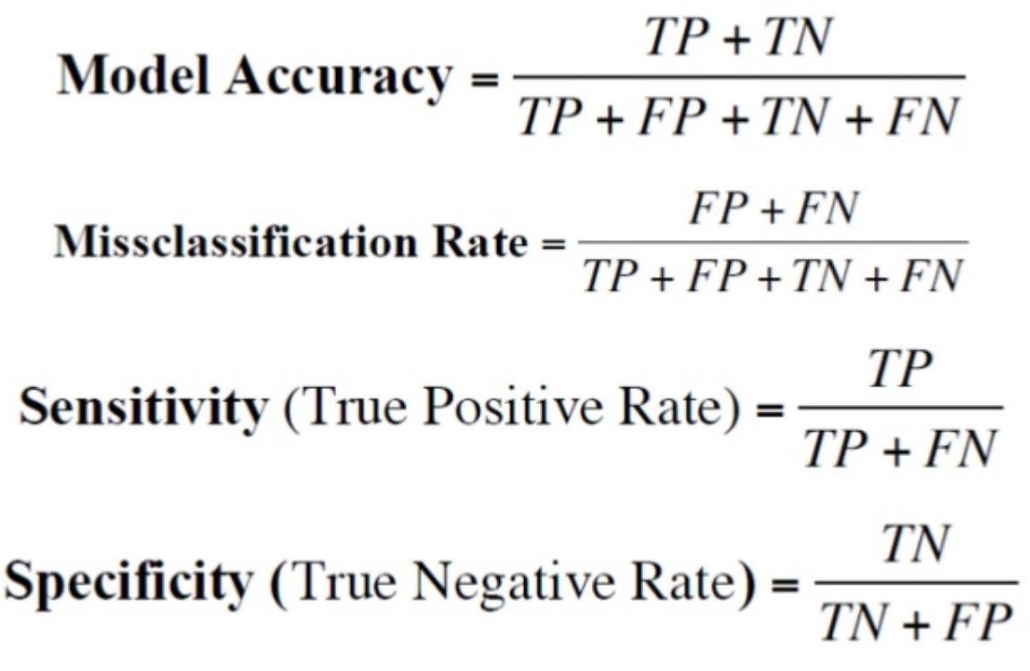
Confusion Matrix
It is a mechanism to show how a model is performing in terms of false positives and false negatives.
Provides more information than a single accuracy figure.
Extendable to any number of classes.

Slide 19
Cross Validation
What if the training-test split is not random?
This will result in overfitting or under-fitting.

Slide 20
Thanks!
Any questions?

